Slide 1
Intro to Mythology

Slide 2
FYI:
You will need to read EACH slide carefully, so you do not miss anything.

Slide 3
What is a myth?
A story created by a whole group of people or a society to explain their beliefs
Deals with super natural beings, ancestors, and heroes
Usually spread by word of mouth (orally)

Slide 4
Purposes of Mythology
Scientific: explain things in nature; explain the unexplainable (i.e. seasons)
Literary- good storytelling; entertainment
Religious- explain the role of gods in everyday life; give meaning to life; give guidelines for how people should live their lives

Slide 5
Types of Myths
Cosmic myths:
About creation and the end of the world
Theistic myths:
About gods such as Zeus or Athena
Hero myths:
About individuals such as Heracles, Perseus, and Achilles
Place/Object myths:
- About items or places such as the golden fleece; the Trojan war

Slide 6
Eight Elements found in Mythology
Sometimes written to explain natural phenomena, such as why the sun rises, why it rains, how the earth began.
Contain good and evil royalty, like kings and princesses, etc.
Sons are often raised by someone besides their birth parents.
Contain imaginary creatures, people, or animals that have unusual qualities.
The hero uses magic to move the plot along.
The gods play a significant role in helping or getting in the way of the main character(s).
The “good” characters of the story show similar characteristics (young, handsome, clever, thoughtful), etc.
Rely on the belief of fate, that you have a destiny that cannot be changed unless the Oracle chooses to change it.

Slide 7
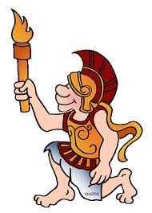
Why do we study mythology?
To learn about ancient cultures
As inspiration for our own art and writing
To teach values and morals
For entertainment

Slide 8
Which cultures have myths?
Every culture has its own mythology, but there are universal symbols and themes that connect them all

Slide 9
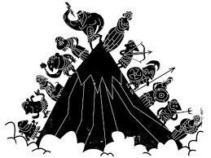
Ancient Greek and Roman Mythology is often called “Classical Mythology”

Slide 10
Ancient Greek Culture
Pantheistic- they believed in many gods, who often acted humanly, showing emotions like rage, jealousy, and depression
The biggest “sin” an ancient Greek could commit was HUBRIS, the belief that one is better than or doesn’t need the gods).
People were driven by honor; reputation and legacy were very important; revenge was admirable and respectable.
Hospitality was also important.
Greek society flourished between 800 and
30 BCE. Some of the legends in mythology
(The Trojan War, Oedipus, Odysseus, etc.)
refer back to “specific” history dating back
even further. For example, the Trojan War stories are set around 1300 BCE.

Slide 11
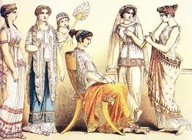
Legacy of the ancient Greeks
Science and mathematics
System of medicine
Philosophy shaped western civilization and thought
Arts, drama, poetry, sculpture, literature, architecture
Law, government, democracy developed in Athens
Military tactics

Slide 12
Influence of the Romans
In the last century, before the birth of “Christ,” the Roman empire expanded and became more powerful than Greece.
In 146 BC, Romans took over much of Greece.
The Romans were influenced by the Greeks and adopted Greek myths, but with their own gods as charcters.
Eventually, they became almost exactly alike.
Therefore, there are both Greek and Latin names for the gods.

Slide 13
On to your next task…

